Slide 1

How do electric vehicles (EVs), an alternative fuel source, impact the environment?
Avery Gunter, Ray Zhou, Cameron Smith, Haslett Flores

Slide 2

I. Introduction
For years, the global dependence on fossil fuels for transportation has propelled pollution and environmental concerns. In this study, we discuss the transformative impact of electricity and alternative fuel sources on the environment, focusing particularly on electric vehicles (EVs). The research is designed to unravel key aspects of EVs, including battery composition, global adoption rates, disposal effects, and sustainability compared to traditional electricity and synthetic fuels. This investigation is crucial for validating EVs in sustainable transportation practices and guiding the ongoing shift away from fossil fuels.
The central question guiding this exploration is: How do electric vehicles (EVs), as alternative fuel sources, impact the environment?
Understanding EV Battery Composition: Delving into the batteries powering the latest electric cars and their composition is fundamental for assessing the environmental impact of EVs and shaping the future of sustainable transportation.
Global Adoption of Alternative Fuels: Examining the global adoption of alternative fuel vehicles is critical for understanding their environmental impact, reducing greenhouse gas emissions, and influencing future energy policies.
Greenhouse Gases and Their Environmental Role: Exploring the constituents and consequences of greenhouse gases emphasizes the role of EVs in combating climate change and promoting a cleaner planet, contributing to environmental efficacy.
Ecological Implications of EV Battery Disposal: Investigating the ecological consequences of EV battery disposal addresses the long-term sustainability of EV integration, promoting responsible end-of-life practices.
Comparative Sustainability of Synthetic Fuels: Evaluating the comparative sustainability of synthetic fuels versus traditional electricity informs choices for achieving greener and more efficient transportation, steering the transition to cleaner alternatives.
In summary, this study aims to contribute vital insights to the discourse on eco-friendly transportation, influencing the trajectory of the automotive industry and its environmental impact.

Slide 3

II. Background
In the research of sustainable transportation, electric vehicles (EVs) have emerged as a beacon of hope for reducing greenhouse gas emissions and enhancing urban sustainability within smart cities especially [1]. However, as the promise of EV integration into these cities is bright, it's essential to acknowledge the significant risks and challenges. Most research has traditionally concentrated on the technical hurdles, inadvertently overlooking other crucial factors of this transformation [1]. By categorizing these challenges into technical, economic, social, and environmental aspects, it emphasizes the importance of taking a holistic approach to EV integration into smart cities.
One of the primary debates within the EV landscape revolves around the choice between synthetic fuels and batteries [2]. The discussion centers on which is the more environmentally responsible alternative to traditional gasoline-powered vehicles. Synthetic fuels may serve as a temporary substitute, yet they fail as a long-term solution for reducing carbon emissions. This is mainly due to their lower efficiency compared to batteries and the increase in electricity generation required to power the existing cars [2].
As the adoption of EVs continues to grow, so does the concern about the proper disposal of aging lithium-ion batteries (LIBs). Sustainable management of LIBs has become a crucial topic. The hierarchy of waste management emphasizes avoiding the use of critical materials and recycling, but it places particular importance on reusing LIBs as energy storage systems [3]. It is imperative that sustainable waste management practices address this pressing issue effectively.
Shifting our focus to a regional context and providing a unique perspective on India's efforts to transition to electric vehicles. India, a significant consumer of imported crude oil, faces a substantial economic burden due to the many petrol and diesel vehicles. While the country stives to embrace the EV trend, the challenges stem from the consumer mindset [4]. The study reveals that factors like fuel prices, environmental consciousness, and price level with traditional fuels significantly influence consumers' preferences for electric vehicles. This regional perspective highlights the complexities of transitioning to electric vehicles.
Finally, in evaluating electric vehicles, a balanced perspective on the pros and cons of electric cars and hybrid vehicles is essential. Highlighting their benefits, including low maintenance and high-power delivery. The limitations of electric vehicles, such as expensive battery replacements and the limited availability of power chargers [5]. Also, the financial aspects of electric vehicle ownership and the need for infrastructure development take the spotlight.
In conclusion, the research on electric vehicles is large, including their integration into smart cities, the comparison of alternative propulsion methods, the sustainability of lithium-ion batteries, the regional context of EV adoption, and the evaluation of electric cars and hybrid vehicles. These topics converge to provide a holistic understanding of the evolving landscape of electric vehicles and their contribution to sustainable and eco-friendly transportation. As we move forward, these findings offer a roadmap for a sustainable and environmentally conscious transportation future, but more information and research are needed to decipher how to go about Electric Vehicles and pollution.

Slide 4
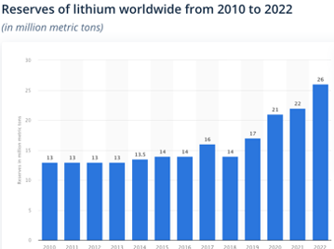
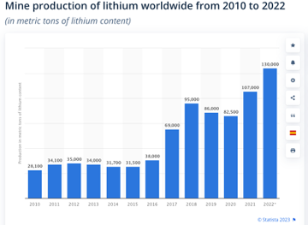
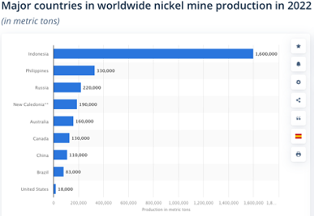
III. Methods
What batteries are being used in the latest electric cars? What are these batteries composed of? Electric cars use lithium-ion batteries, and they also contain metal oxide and carbon. The process in these batteries include the anode, cathode, separator, electrolyte, and lithium ions. A typical EV battery (NMC532) contains roughly 8 kilos (17 lbs) of lithium carbonate, 35 kilos (77 lbs) of nickel, 20 kilos (44 lbs) of manganese and 14 kilos (30 lbs) of cobalt. According to the Department of Energy’s National Blueprint for Lithium Batteries, the element lithium is a critical material for the production of EV batteries, and the demand for them has skyrocketed. However, cobalt, nickel and lithium are all extracted using environmentally-damaging methods. But, researchers are developing new ways to mine these materials like lithium. China currently dominates the global EV and EV supply-chain market, but half of the world’s cobalt originates from the Democratic Republic of Congo. For the countries of Indonesia, Australia, and Brazil, they make up the share of global nickel reserves. Finally, for lithium, South America’s ‘Lithium Triangle’ consisting of Bolivia, Chile and Argentina.
In 2022, the total worldwide mine production volume of cobalt stood at an estimated 190,000 metric tons.
Global production of nickel from mines was estimated to amount to a total of 3.3 million metric tons in 2022.
According to the U.S. Geological Survey (USGS), Earth plays host to some 88 million tons of lithium.
Method: The data on the graphs are obtained by Statista. Statista is a global database with thousands of topics and sources.

Slide 5
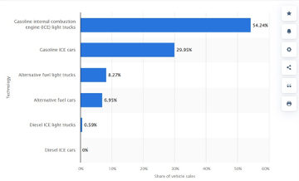
III. Methods
Question2: What percentage of the United States is using alternative fuel vehicles? A significant 84% of vehicles worldwide rely on traditional gasoline as their primary fuel source, whereas a mere 15% are powered by alternative fuels. This stark imbalance underscores the ongoing imperative to address carbon emissions and transition to more sustainable and environmentally friendly transportation options. Achieving a greater shift toward alternative fuel vehicles is a crucial step in mitigating the environmental impact of the global automotive industry.
The data on the webpage was gathered by Statista. Statista is a global database with thousands of topics and sources. This dataset was researched by Mathilde Carlier is researching alternatively powered vehicles

Slide 6
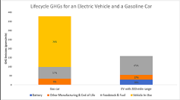
III. Methods
Question3: What is and is in greenhouse gases and what is its effect on the environment? Greenhouse gases are gases that trap heat in the Earth’s atmosphere and contribute to the greenhouse effect. This Graph shows greenhouse gas emissions associated with an electric vehicles over its lifetime, which are typically lower than those from an average gasoline-powered vehicle, even when accounting for manufacturing. The provided graph compares the lifecycle greenhouse gas (GHG) emissions of EVs and gasoline-powered vehicles. The graph shows that EVs have lower GHG emissions than gasoline-powered vehicles over their lifetime, even when accounting for manufacturing emissions. The graph also shows that the GHG emissions from EVs decrease as the electricity grid becomes cleaner.
Key-
Blue: emissions associated with the battery
Orange: the rest of the vehicle manufacturing (e.g., extracting materials, manufacturing and assembling other parts, and vehicle assembly) and end-of-life (recycling or disposal)
Gray: represents upstream emissions associated with producing gasoline or electricity
Yellow: shows tailpipe emissions during vehicle operations
The data on the webpage was gathered by the US Environmental Protection Agency (EPA). The EPA conducted a lifecycle assessment of EVs and gasoline-powered vehicles to compare their GHG emissions over their lifetime. The assessment included the GHG emissions associated with vehicle production, fuel production, vehicle operation, and end-of-life disposal. The EPA used a model called the Greenhouse Gases, Regulated Emissions, and Energy Use in Transportation (GREET) model to estimate the GHG emissions associated with each stage of the vehicle’s life cycle
(bar graph with two bars, one for gasoline-powered vehicles and one for EVs. The bars are divided into three sections: manufacturing, operation, and end-of-life)

Slide 7
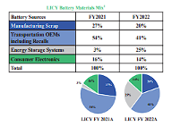
III. Methods
Question4: How does disposing the batteries of EV’s affect the environment? The Circle graph and chart have the percentages of the company's products where they came from and the amount of the materials, they were able to recycle.
Data: There is this company out in Arizona that has specialized in recycling lithium-ion batteries, and they say if the batteries come to them that the batteries can be recycled to an infinite number of times and, that 95% of the battery's resources are able to be recycled as well.

Slide 8
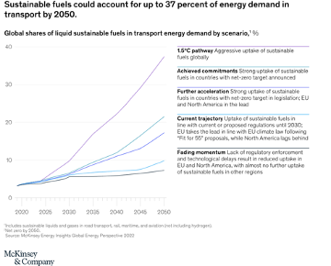
III. Methods
III. Methods
Question5: Are synthetic fuels a better alternative than electricity? The article discusses the role of sustainable fuels in decarbonizing energy systems. The graph shows that the share of sustainable fuels in transportation’s energy demand is expected to increase significantly over time, with a range of 7% to 37% by 2050. Sustainable fuels are expected to play an increasingly important role in transportation, including aviation and heavy-duty road transport. Growth in sustainable fuels until 2035 is driven primarily by road transport, while aviation plays an increasingly important role thereafter. The main goal of using alternative fuels is to quickly decrease the carbon put off by cars but does not seem to be the long-term solution.
(The graph shows the projected share of sustainable fuels in transportation’s energy demand by 2050, based on net-zero ambition levels across countries. The x-axis represents the years from 2020 to 2050, while the y-axis represents the percentage of sustainable fuels in transportation’s energy demand.)
The data for this article was gathered by McKinsey & Company, a global management consulting firm. The report provides an outlook to 2050 for each energy type and carrier, including hydrogen, sustainable fuels, natural gas, oil, and coal, as well as a view on the role of carbon capture, utilization, and storage (CCUS). Most of the data was primary research involving interviews with industry experts and stakeholders, while secondary research involved reviewing of existing literature and data sources.

Slide 9
IV. Results
Impact of Electric Vehicles on the Environment: Electric vehicles (EVs) have emerged as a promising alternative to traditional gasoline-powered cars, primarily relying on lithium-ion batteries. These batteries, consisting of metal oxide and carbon, comprise essential components such as lithium ions. While the demand for these critical materials has surged, the extraction methods for cobalt, nickel, and lithium have raised environmental concerns. Notably, efforts are underway to explore more sustainable mining practices for these materials. However, the global EV and supply-chain market is currently dominated by China, highlighting geopolitical complexities, such as cobalt extraction from the Democratic Republic of Congo, nickel reserves in Indonesia, Australia, and Brazil, and lithium production in South America's 'Lithium Triangle.'
Usage of Alternative Fuel Vehicles: A mere 15% of vehicles globally are powered by alternative fuels, emphasizing the overwhelming reliance on traditional gasoline, which constitutes 84% of the worldwide vehicle fleet. This stark imbalance underscores the urgent need to address carbon emissions and transition towards more sustainable and environmentally friendly transportation options. Achieving a substantial shift towards alternative fuel vehicles is crucial for mitigating the environmental impact of the global automotive industry and promoting a greener future.
Greenhouse Gases and their Environmental Impact: Greenhouse gases, responsible for trapping heat in the Earth's atmosphere and contributing to the greenhouse effect, are a critical consideration in the environmental impact of electric vehicles. A provided graph comparing lifecycle greenhouse gas emissions of EVs and gasoline-powered vehicles reveals that EVs generally have lower emissions over their lifetime. This holds true even when accounting for manufacturing emissions. The graph further highlights a decrease in EV emissions as the electricity grid becomes cleaner, emphasizing the role of cleaner energy sources in enhancing the environmental benefits of electric vehicles.
Impact of EV Battery Disposal on the Environment: Disposing of EV batteries is a critical aspect of the environmental equation. A circle graph and chart illustrate the percentages of company products and the amount of materials recycled, shedding light on the recycling efforts within the industry. The environmental impact of EV battery disposal is a complex issue, requiring careful consideration of recycling practices to minimize ecological repercussions.
Sustainable Fuels vs. Electricity: The role of sustainable fuels in decarbonizing energy systems is explored, presenting a graph indicating the expected increase in the share of sustainable fuels in transportation's energy demand by 2050. Sustainable fuels are anticipated to play a progressively significant role. While their growth until 2035 is primarily driven by road transport, aviation becomes increasingly important thereafter. The data suggests that sustainable fuels offer a short-term solution to reducing carbon emissions from cars, prompting further exploration for long-term sustainability in transportation alternatives.

Slide 10

V. Discussion
The discussion reveals a comprehensive analysis of the environmental effects of electric vehicles (EVs). Firstly, the environmental impact of EV battery production is highlighted by the substantial quantities of critical materials like lithium, nickel, manganese, and cobalt required. This aligns with the emphasis on the challenges posed by the extraction of these materials, emphasizing the need for alternative and more sustainable mining methods. The worldwide spread of these crucial elements adds a political and geographical aspect, which reinforces the demand for a comprehensive strategy for integrating electric vehicles into smart cities, considering the intricacies of the global supply chain. The upward trend in global lithium production accentuates the surge in demand for EVs. However, the limitations of the data urge a deeper exploration into the sustainability of increased lithium production. Shifting towards alternative fuels becomes imperative when considering the overwhelming reliance on traditional gasoline revealed by the data. With only 15% of vehicles powered by alternative fuels, the stark contrast underscores the urgent need for a transition to more sustainable alternatives to address carbon emissions. Data on greenhouse gas emissions and EV lifecycle assessment supports the focus on reducing environmental impact. The representation of lower greenhouse gas emissions of EVs over their lifetime aligns with the claims regarding the environmental benefits of electric vehicles. The decreasing greenhouse gas emissions with a cleaner electricity grid coincides with the argument for transitioning to cleaner energy sources. The data aligns with the focus on recycling lithium-ion batteries for sustainable waste management. However, limitations such as the lack of specific data needed for a more thorough assessment of recycling practices. It also acknowledges assumptions and limitations, including the reliability of data sources, possible variations in mining practices, and geopolitical complexities not fully covered in the data.

Slide 11

VI. Conclusion
The purpose of this research is to explore the positive and negative impacts of alternative fuel sources for vehicles on the environment, since gas-powered cars are the main cause of greenhouse gases hurting our environment. The exploration into the environmental impact of electric vehicles (EVs) sheds light on critical aspects of their production, usage, and disposal. The shift from fossil fuel-dependent transportation to electricity as an alternative fuel source creates a thorough investigation into EV battery components and extraction methods. Our study examines the global adoption of electric vehicles, revealing a surge in demand mirrored by the upward trend in lithium production. However, there is a need for a more in-depth exploration of the sustainability of increased lithium production. The contrast between the reliance on traditional gasoline and the limited use of alternative fuels emphasizes the urgency for a transition to more sustainable options to curb carbon emissions. The findings align with the environmental benefits of EVs, emphasizing the importance of cleaner energy sources and recycling practices.

Slide 12
VII. References
[1] O. Apata, P. N. Bokoro, and G. Sharma, “The risks and challenges of electric vehicle integration into Smart Cities,” MDPI, https://www.mdpi.com/1996-1073/16/14/5274 (accessed Oct. 28, 2023).
[2] J. Morris, “Synthetic fuels won’t save the planet, so don’t say they could,” Forbes, https://www.forbes.com/sites/jamesmorris/2021/03/27/synthetic-fuels-wont-save-the-planet-so-dont-say-they-could/?sh=5427db9c69a4 (accessed Oct. 28, 2023).
[3] Y. Tao, C. D. Rahn, L. A. Archer, and F. You, “Second Life and recycling: Energy and environmental ... - science,” Second life and recycling: Energy and environmental sustainability perspectives for high-performance lithium-ion batteries, https://www.science.org/doi/10.1126/sciadv.abi7633 (accessed Oct. 28, 2023).
[4] C. J. Nirmala and J. Dsouza, “A Study on the Impact of Perceived Benefits on Customer Preference for Electric Vehicles,” SDMIMD Journal of Management Vol 14, file:///Users/avery/Downloads/A_Study_on_the_Impact_of_Perceived_Benefits_on_Cus.pdf (accessed 2023).
[5] B. McAleer, “Pros and cons of electric cars: Everything you need to know,” Pros and Cons of Electric Cars, https://www.caranddriver.com/features/a41001087/pros-and-cons-electric-cars/ (accessed Oct. 14, 2023).

